Slide 1


Slide 2

PROBLEM !!
OPAQUE, UNTRACEABLE AND UNSECURE NATURE OF SUPPLYCHAIN
People nowadays are more conscious about their clothes' quality. So can Brands, Manufacturer and Supplier trust blindly?
Bijou Solutions, Inc. | 2020

Slide 3
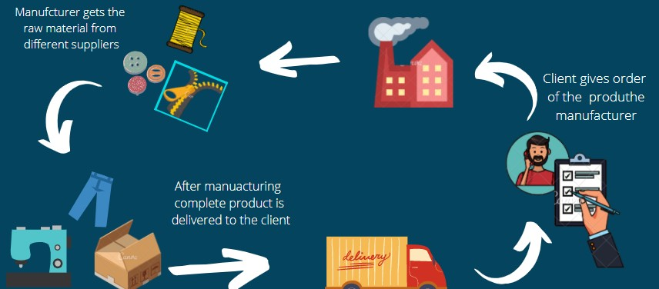
WHERE IS TRACEABILITY?

Slide 4
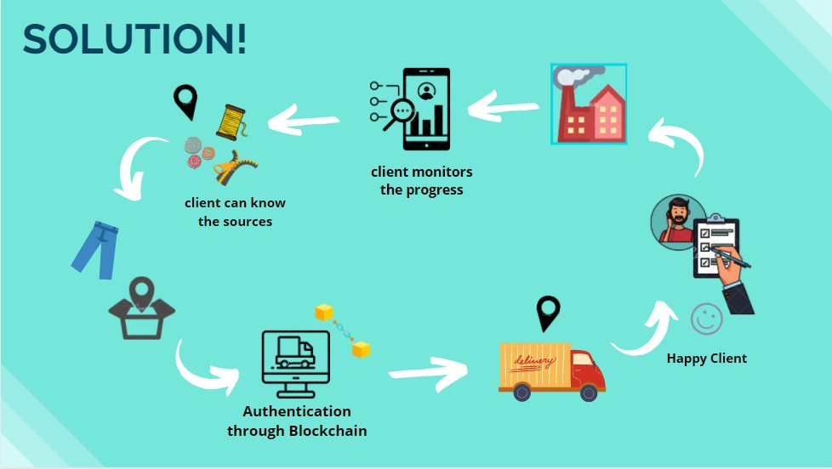

Slide 5

LET THE CLOTH TELLS ITS ORIGIN AND PRODUCTION STORY, INSTEAD OF
SIMPLE “MADE IN” LABEL.

Slide 6

TARGETED AUDIENCE
Short scale Local Textile Firms
IN FUTURE WE WILL TARGET LARGE SCALE FIRMS ALSO.

Slide 7

ENTITIES INVLOVED
WHAT ACTORS WILL BE INVOLVED IN THIS SYSYTEM?

Slide 8
KEY PROMISING FEATURES
TRACEABILITY
MANAGEMENT
TRANSPARENCY
AUTHENTICITY
Brands and clients can easily trace their product to their origin in real time and can know about their sources.
Manufacturers can easily manage their stock so that prevent them from overstocking.
The path of the product will be complete transparent.
Clients can know easily about the manufacturing details.
Authentication of transaction will be provided and can done through smart contracts and QR Code.

Slide 9

Do Similar Systems Exists?
YES THIS SYSTEM EXISTS IN INTERNATIONAL MARKETS BUT NOT YET INTRODUCED IN LOCAL MARKET
Textile Genesis
HONKONG BASED COMPANY.
Provenance
UK BASED COMPANY

Slide 10
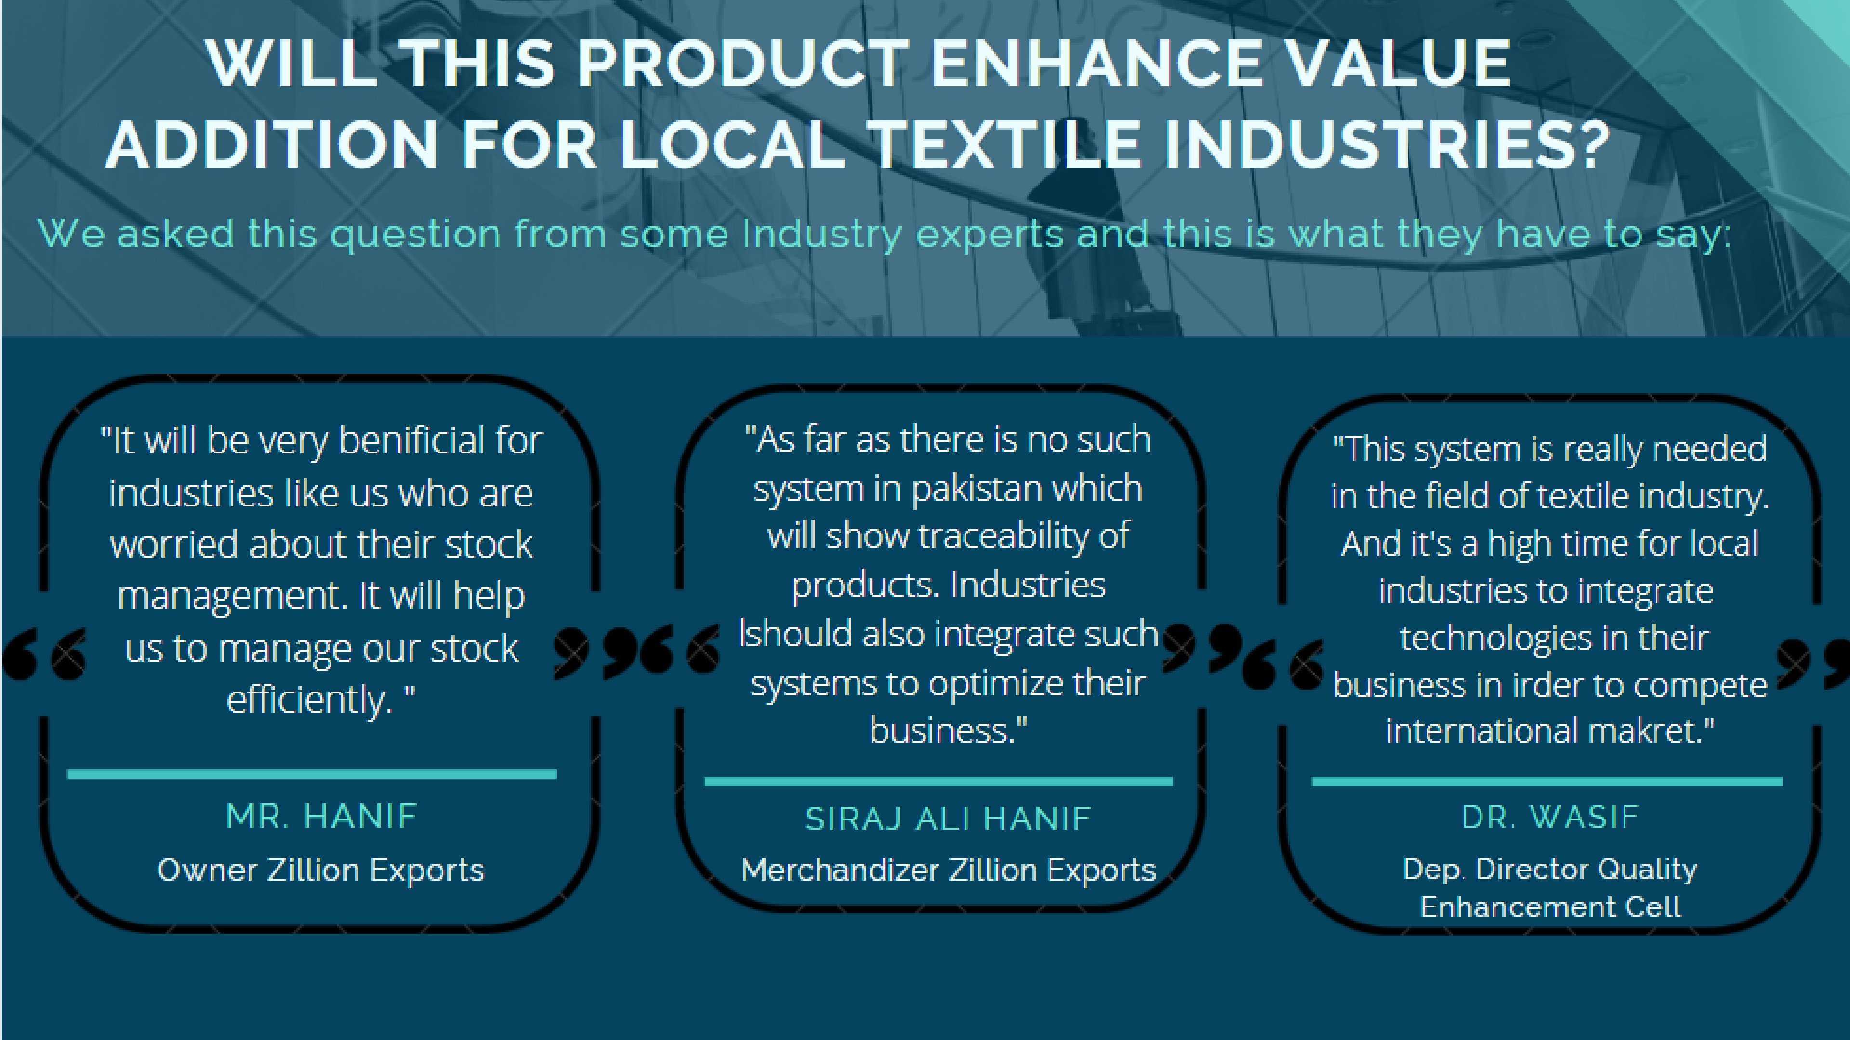

Slide 11


CURRENT FOCUS
For we will focus on three entities that are Brands, Manufacturers and Suppliers.
We are focusing on short scale firms and industries.
FUTURE PLANS
We may integerate other entites like retailers and logistics.
We will ensure maximum level of security.
We will focus l.arge scale firms and international market

Slide 12
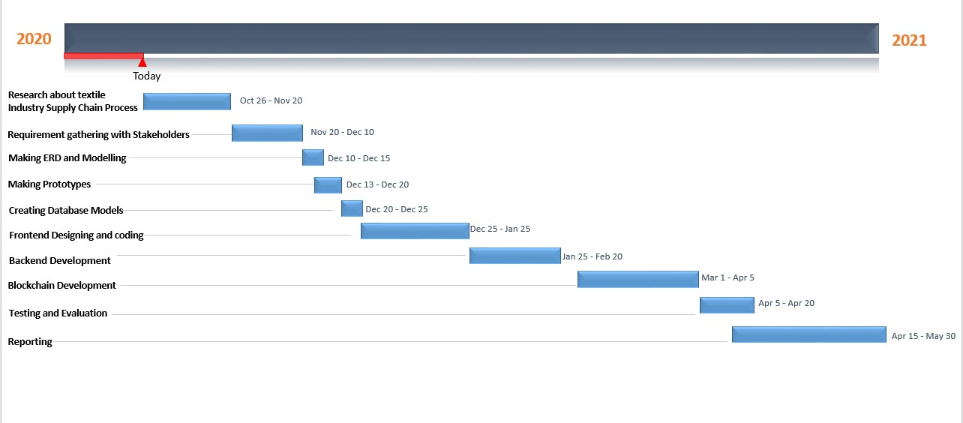
Gantt Chart

Slide 13
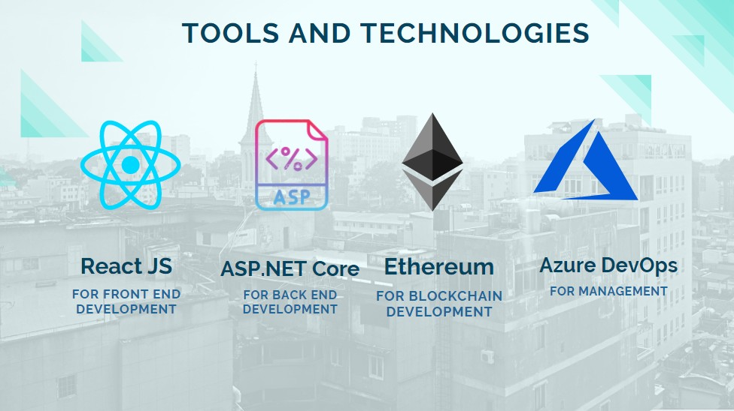

Slide 14




OUR TEAM
AND WORK DISTRIBUTION
MARYAM NADEEM
Front End Blockchain and Testing
JAVERIA ZAFAR
Back End Blockchain and Reporting

Slide 15
Thankyou!
GET IN TOUCH
javeriazafar06@gmail.com maryamnadeem821@gmail.com

